Slide 1
Correlation
Chapter 6

Slide 2
What is a Correlation?
It is a way of measuring the extent to which two variables are related.
It measures the pattern of responses across variables.

Slide 3
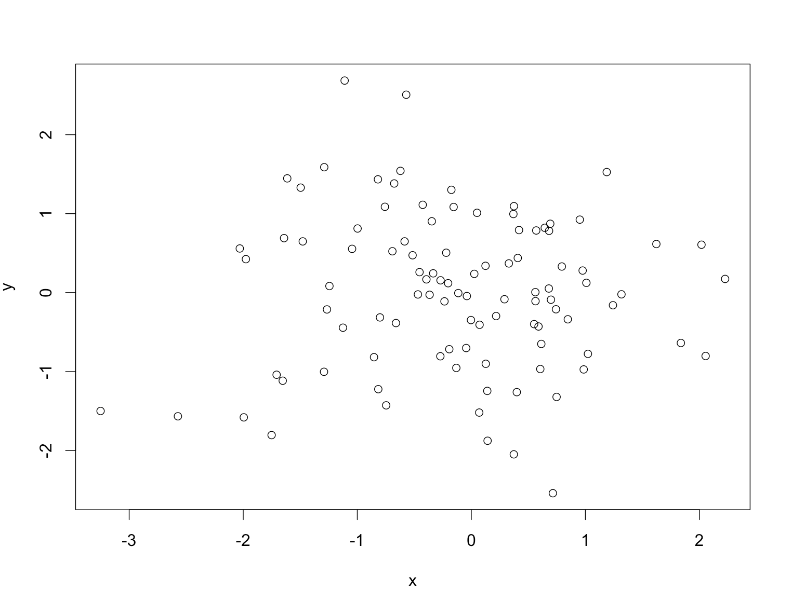
No relationship

Slide 4
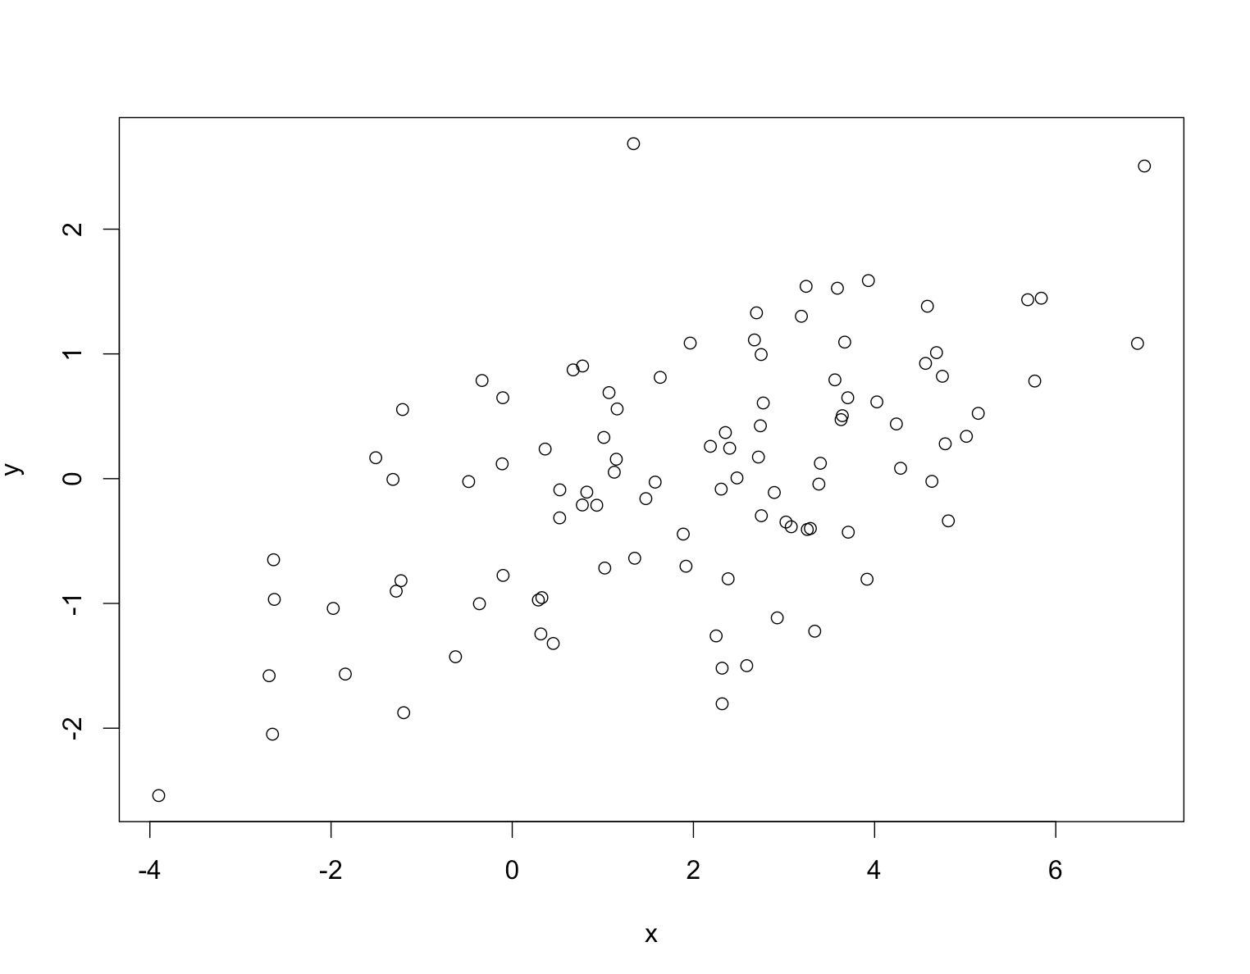
Positive Relationship

Slide 5
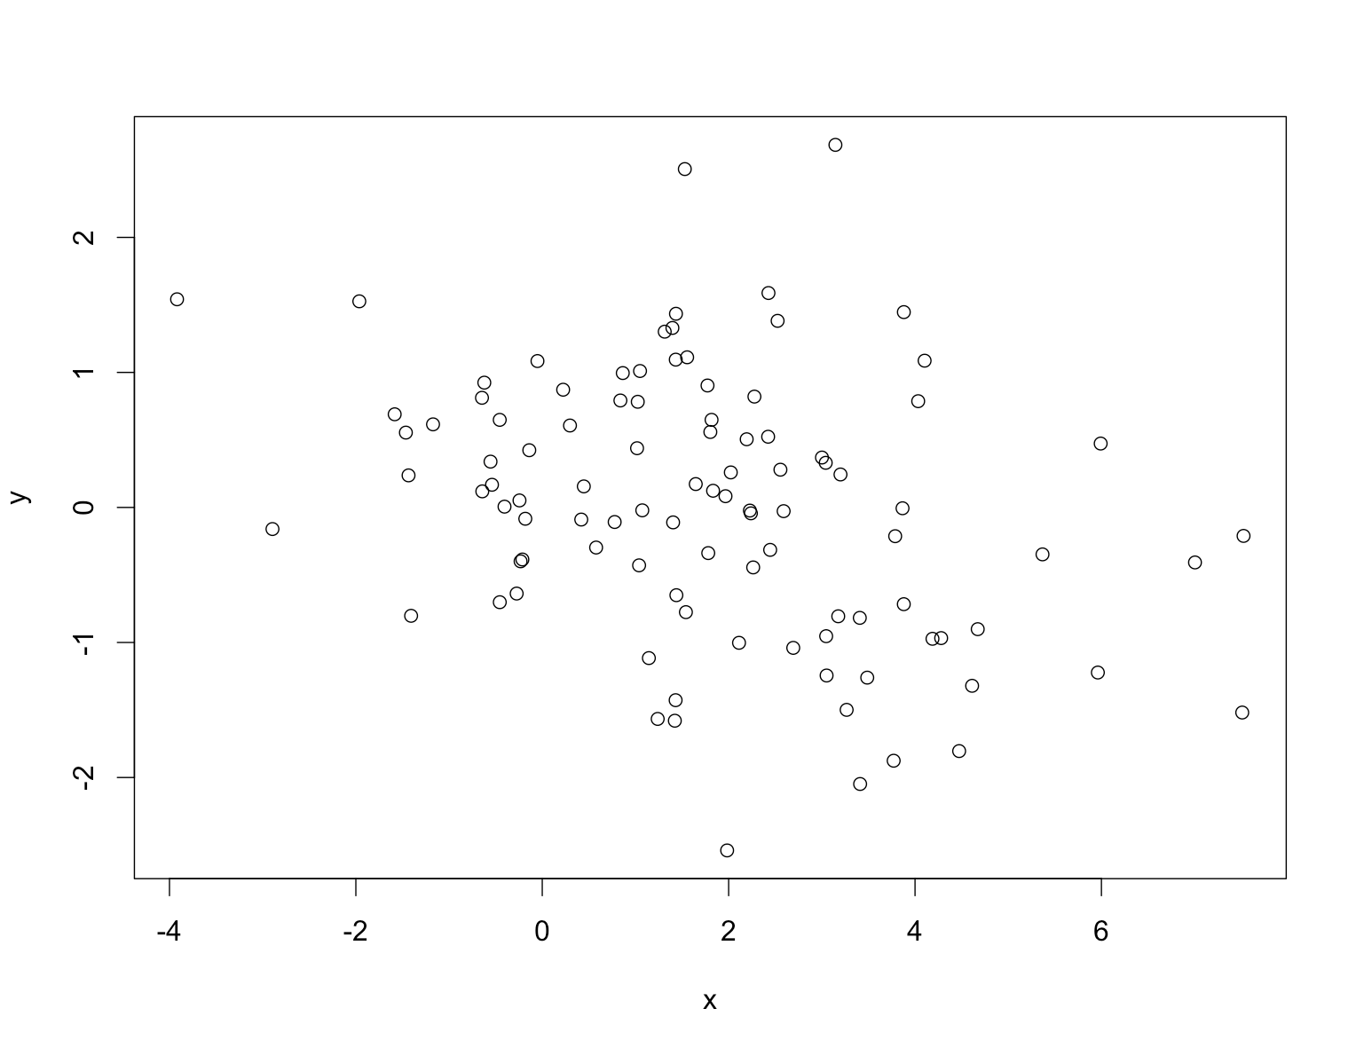
Negative Relationship

Slide 6
Scatterplots
Plotting reminder
ggplot(data, aes(X, Y, color/fill = categorical)
+ cleanup coding
+ geom_point() to get the dots
+ geom_smooth() to get a line
+ xlab/ylab

Slide 7
Scatterplots
Not only do you need to check X and Y for proper labels
Now you need to make sure X and Y are appropriate lengths for your scatterplot
Although this rule is less strictly enforced than the bar graph rule.

Slide 8
Fix the X/Y Axes
coord_cartesian(xlim = NULL, ylim = NULL)
coord_cartesian(xlim = c(0,100), ylim = c(0,101))

Slide 9
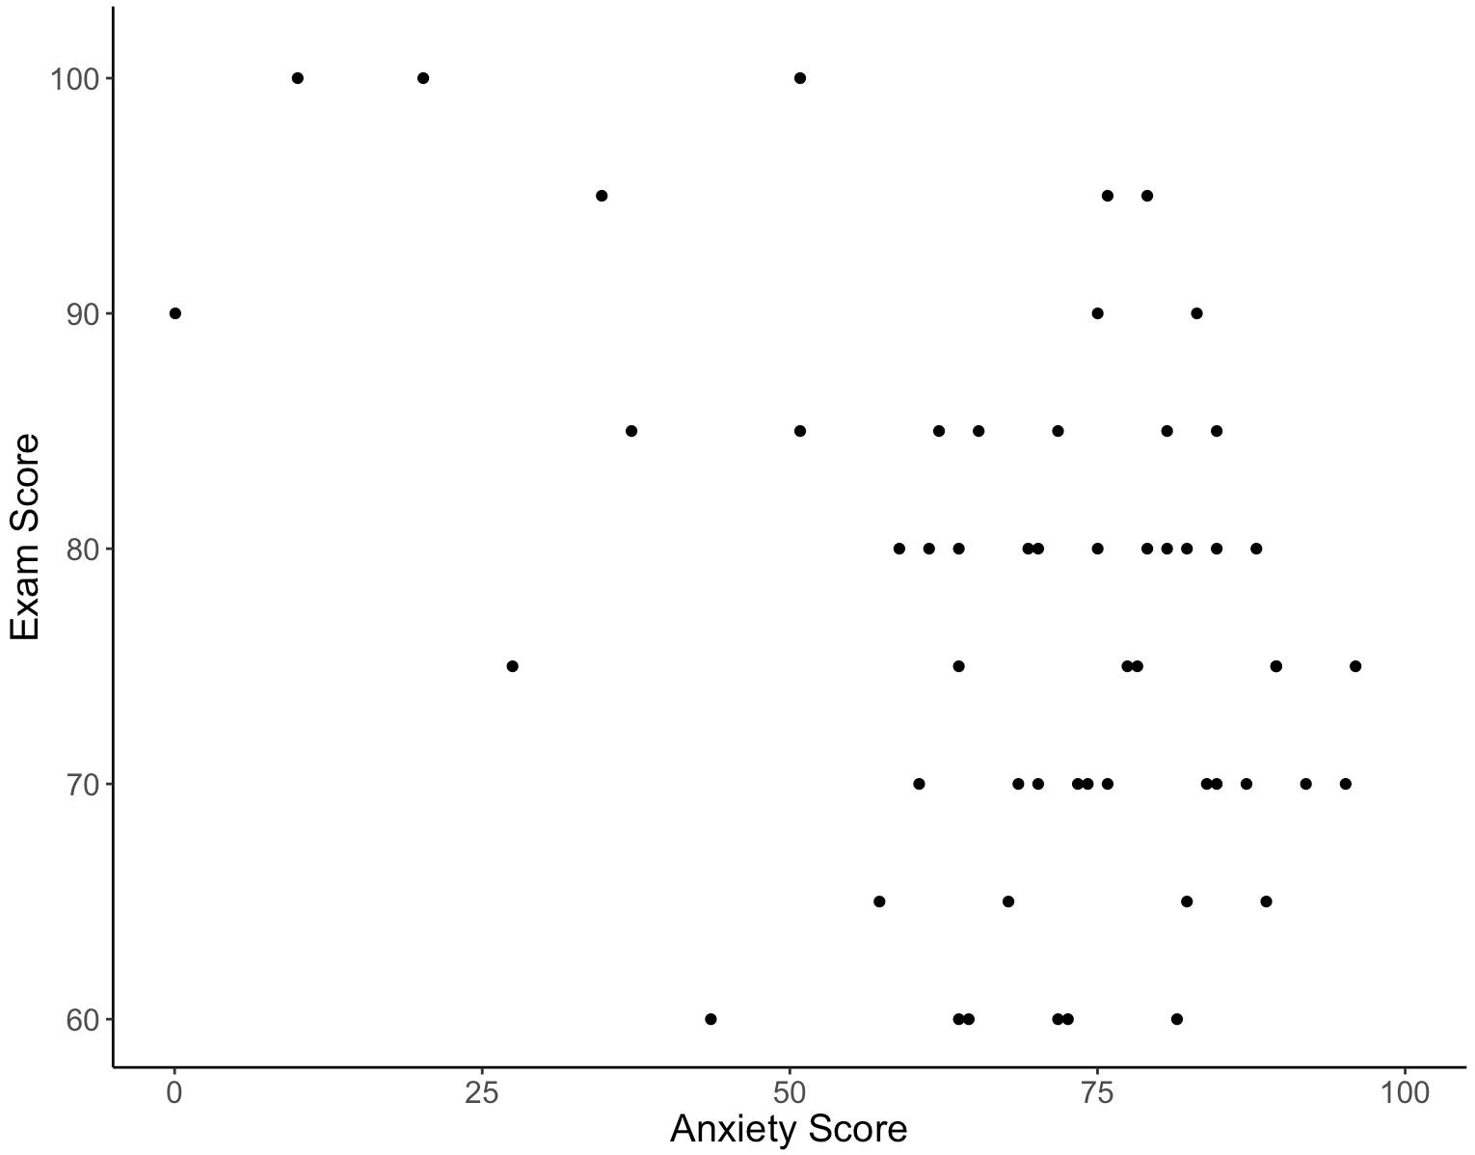

Slide 10
Modeling Relationships
First, look at some scatterplots of the variables that have been measured.
Outcome_{i} = (model ) + error_{i}
Outcome_{i} = (bX_{i}) + error_{i}
b = beta = r when you have one predictor

Slide 11
Modeling Relationships
Outcome_{i} = (model) + error_{i}
Previously, this was Mean + SE
And we used SE to determine if the model “fit” well.

Slide 12
Modeling Relationships
Outcome_{i} = (bX_{i} ) + error_{i}
Now we are using b or r or β (beta) to determine the strength of the model
Traditionally you don’t see the error values reported (sometimes you see CI)

Slide 13
Measuring Relationships
We need to see whether as one variable increases, the other increases, decreases or stays the same.
This relationship can be found by calculating the covariance.
We look at how much each score deviates from the mean.
If both variables deviate from the mean by the same amount, they are likely to be related.

Slide 14
Revision of Variance
The variance tells us by how much scores deviate from the mean for a single variable.
It is closely linked to the sum of squares.
Covariance is similar – it tells is by how much scores on two variables differ from their respective means.

Slide 18
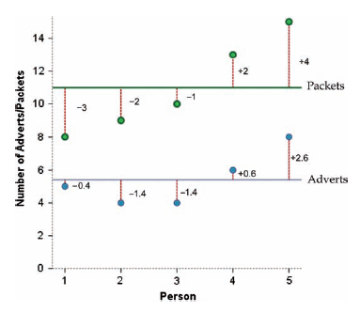

Slide 20
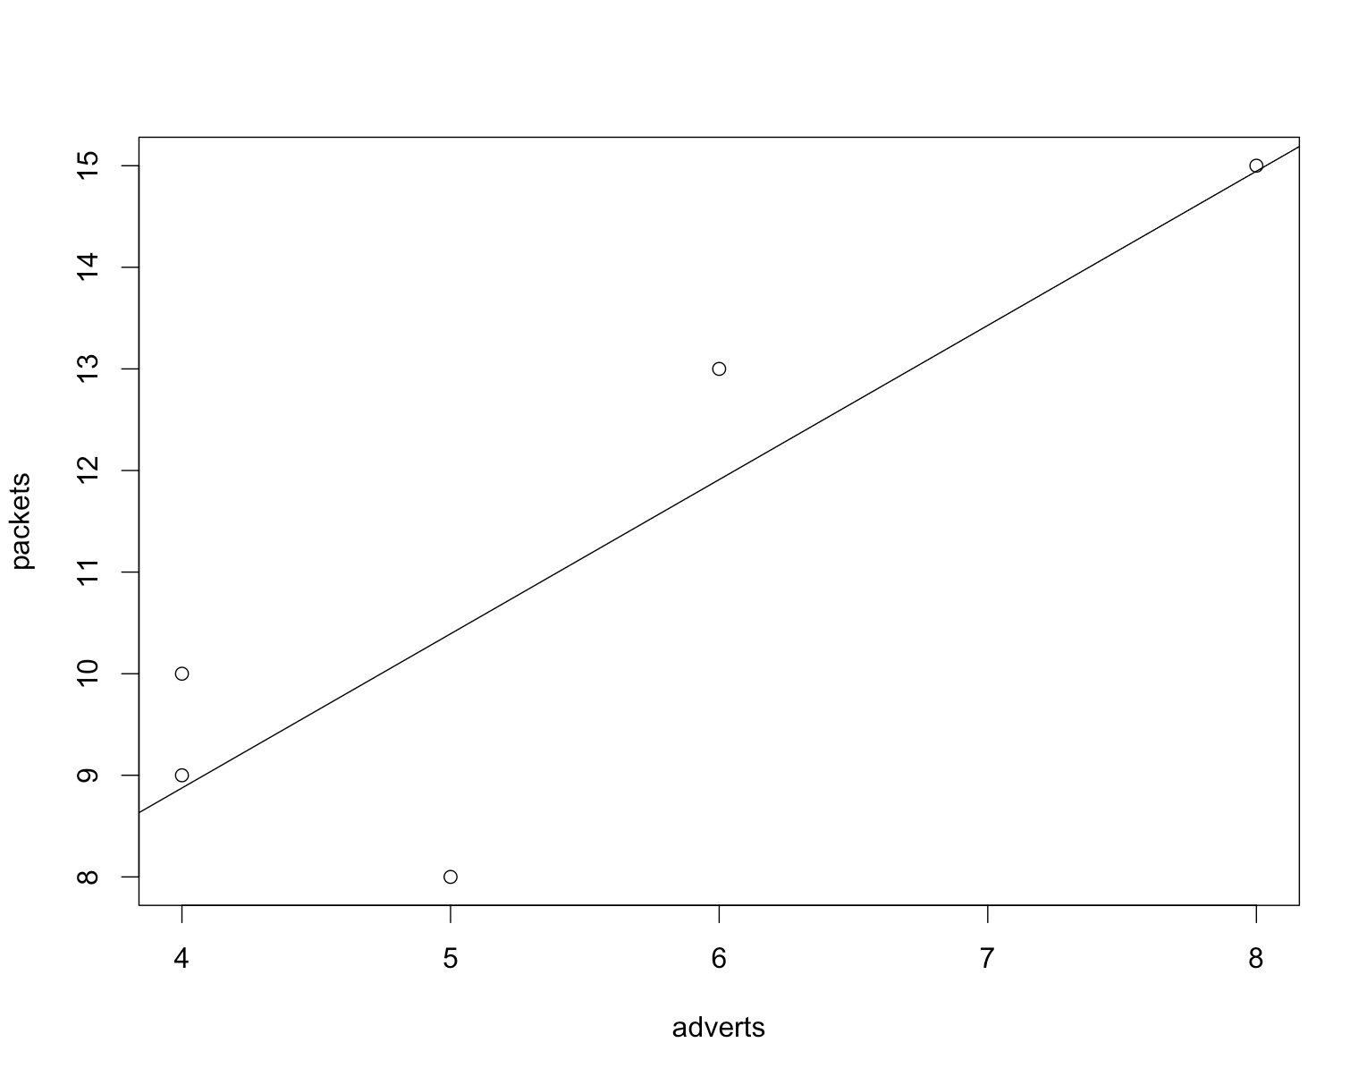

Slide 21
Problems with Covariance
It depends upon the units of measurement.
One solution: standardize it!
Divide by the standard deviations of both variables.
The standardized version of covariance is known as the correlation coefficient.
It is relatively unaffected by units of measurement.

Slide 22
The Correlation Coefficient

Slide 23
The Correlation Coefficient

Slide 24
Correlation Coefficient
Basically, r values have the model + error built into one number
Instead of M + SE
So we can just look at r to determine “model fit” or strength of relationship.

Slide 25
Things to know about the Correlation
It varies between -1 and +1
0 = no relationship
It is an effect size
±.1 = small effect
±.3 = medium effect
±.5 = large effect
Coefficient of determination, r²
By squaring the value of r you get the proportion of variance in one variable shared by the other.

Slide 26
R versus r
R = correlation coefficient for 3+ variables
r = correlation coefficient for 2 variables
r² = coefficient of determination for 2 variables
R² = coefficient of determination for 3+ variables
In reality, we use R² for anything effect size related, even if it’s only 2

Slide 27
Correlation: Example
Anxiety and Exam Performance
Participants:
103 students
Measures
Time spent revising (hours)
Exam performance (%)
Exam Anxiety (the EAQ, score out of 100)
Gender

Slide 28
Assumptions
Accuracy
Missing (exclude pairwise if you don’t fill in)
Outliers
Normality
Linearity**
Homogeneity
Homoscedasticity

Slide 29
How to Calculate
You’ve already been doing these!
cor(x,y)
But what about p values? We’ve only been looking at the magnitude of the correlation for assumption checks.

Slide 30
How to Calculate
cor() function will calculate:
Pearson, Spearman, Kendall, multiple correlations at once
rcorr() function will calculate:
Pearson, Spearman, p values, multiple correlations at once
cor.test() function will calculate:
Pearson, Spearman, Kendall, p values, CI

Slide 31
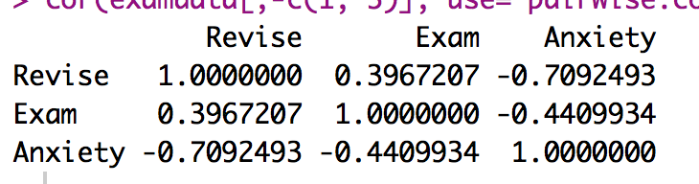
cor output
cor(examdata, use = “pairwise.complete.obs”, method = “pearson”)
Remember these all have to be numeric, no factor variables.

Slide 32
rcorr output
rcorr(as.matrix(examdata), type = “pearson”)
Automatically does pairwise deletion.
All things must be numeric, as well as in matrix format
Load the Hmisc library for this function

Slide 33
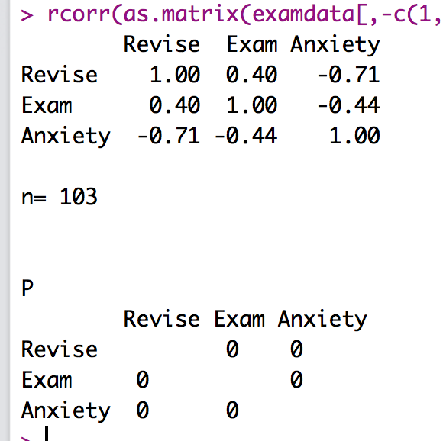
rcorr output

Slide 34
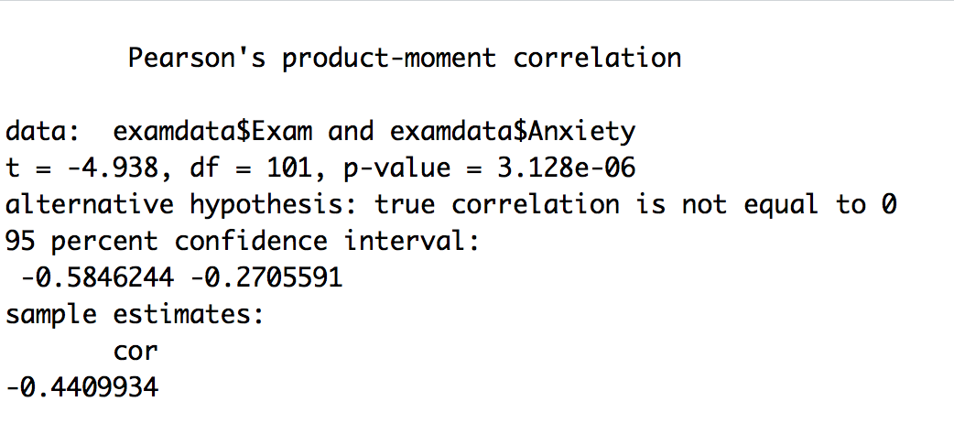
cor.test output
cor.test(x, y, method = “pearson”)
Must use single vectors/columns for x, y

Slide 35
Correlation Interpretation
The third-variable problem:
In any correlation, causality between two variables cannot be assumed because there may be other measured or unmeasured variables affecting the results.
Direction of causality:
Correlation coefficients say nothing about which variable causes the other to change.

Slide 36
Nonparametric Correlation
Spearman’s Rho
Pearson’s correlation on the ranked data
Kendall’s Tau
Better than Spearman’s for small samples
When lots of things have the same rank

Slide 37
Example
World’s best Liar Competition
68 contestants
Measures
Where they were placed in the competition (first, second, third, etc.)
Creativity questionnaire (maximum score 60)
C6 liar.csv

Slide 38
Spearman/Kendall
You can calculate:
Spearman and Kendall with cor() but no p values.
Spearman with rcorr() but no Kendall
All the things with cor.test() but one pair at a time.

Slide 39
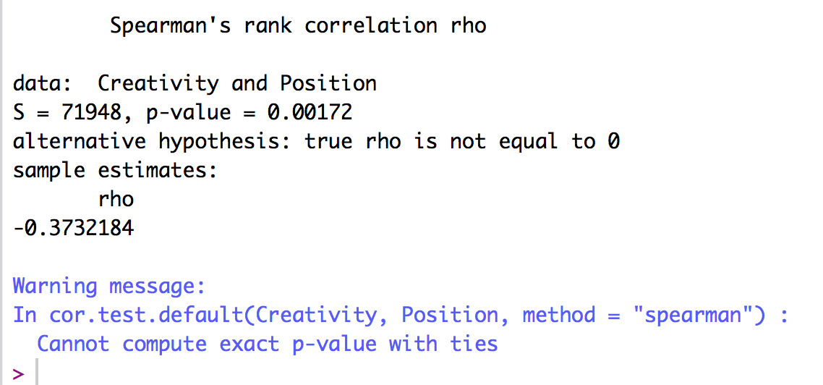
Spearman

Slide 40
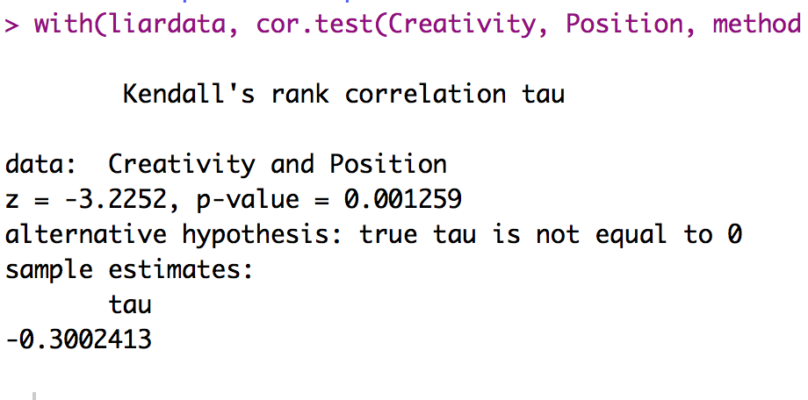
Kendall

Slide 41
A note
All values must be numeric to be able to do any of these correlations
Therefore, if you have any variables that import with labels, you will have defactor them.
as.numeric()

Slide 42
Point vs not point
Point/Biserial correlation = correlation with a dichotomous variable
Which is which?
Point biserial = true dichotomy, no underlying continuum (i.e. gender)
Biserial = not quite discrete (i.e. pass/fail)

Slide 43
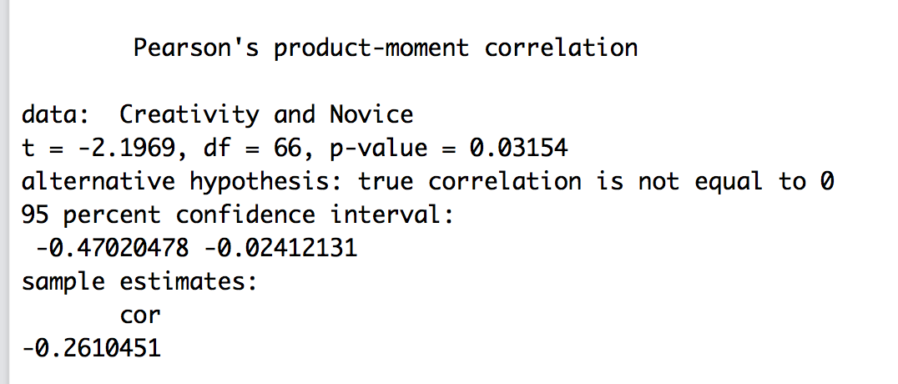
Point vs not point

Slide 44
Comparing Correlations
A question I am asked a lot – how can I tell if these two correlation coefficients are significantly different?
Install package cocor to be able to compare them!

Slide 45
Comparing Correlations
First, you have to decide if the correlations are independent or dependent
Independent correlations → the correlations come from separate groups of people, but are on the same variables
Dependent correlation → the correlations are from the same people, but are different variables (overlapping or not)

Slide 46
Independent Correlations
There’s no split/subset function within cocor.
Therefore, you have to split up the dataset on your independent variable.
(and then put it back together in list format).
Subset the data, then create a list.

Slide 47
Independent Correlations
cocor(~ X + Y | X + Y, data = data)
Fill in X and Y with your variables you want to correlate
(on these they are likely to be the same).
Data = new list we just created.

Slide 48
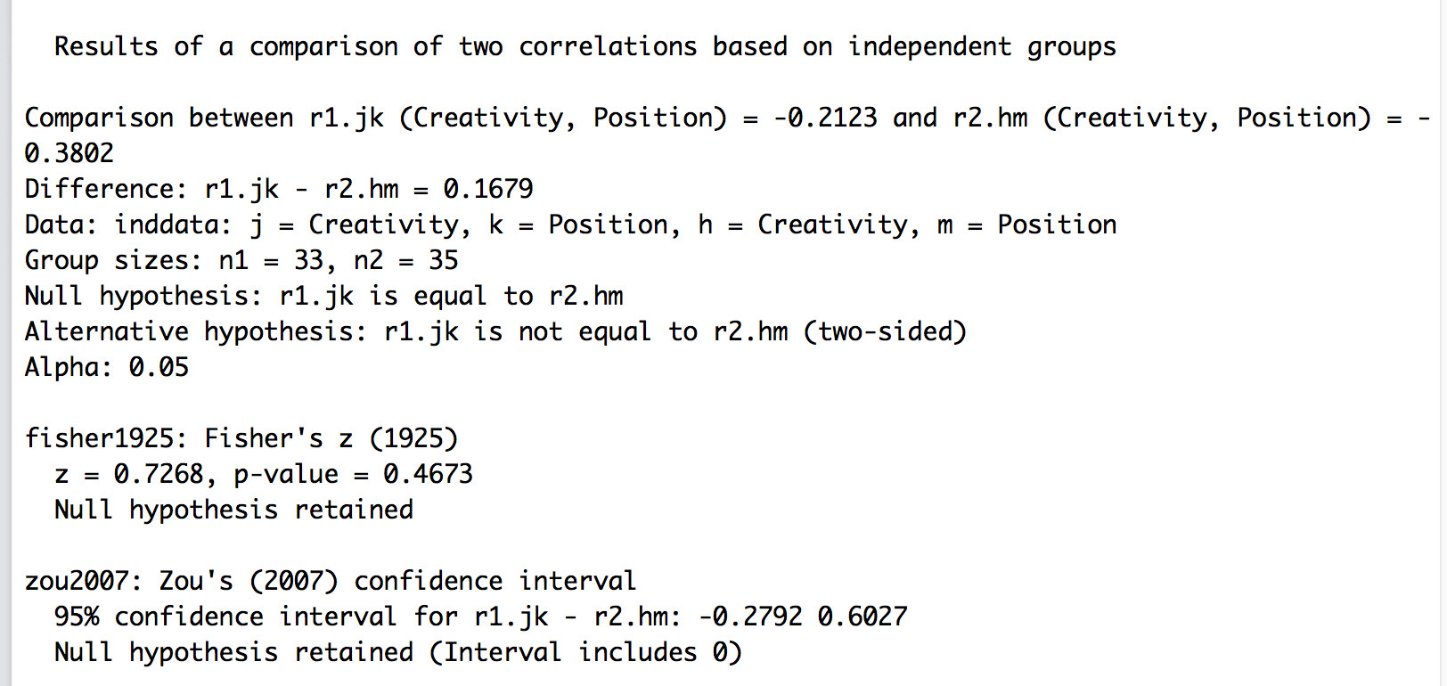
Independent Correlations

Slide 49
Dependent Correlations
cocor(~ X + Y | Y + Z, data = data)
Fill in X, Y, Z with your variables you want to correlate
Overlapping correlation
You can also have X + Y | Q + Z
Non-overlapping correlation
Data is the dataframe with all of the columns

Slide 50
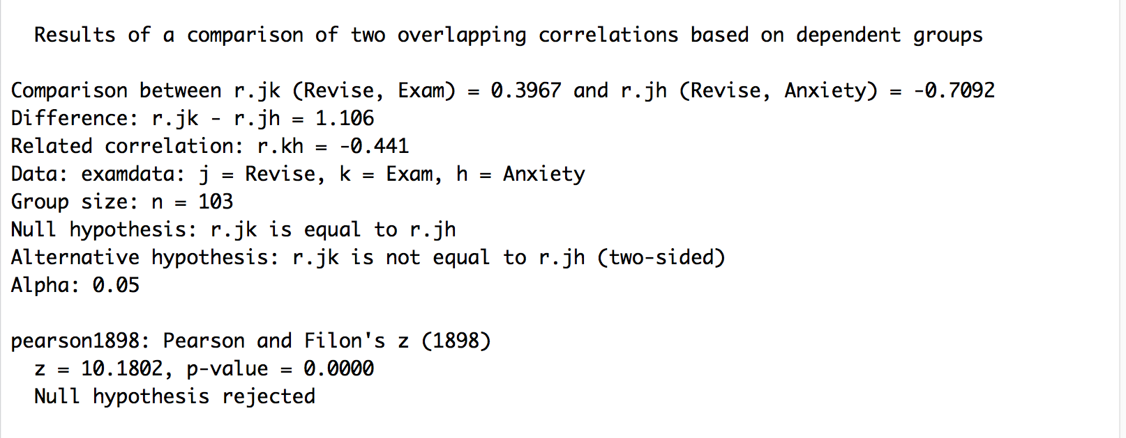
Dependent Correlations
So much output!

Slide 51
Partial and Semi-Partial Correlations
Partial correlation:
Measures the relationship between two variables, controlling for the effect that a third variable has on them both.
Semi-partial correlation:
Measures the relationship between two variables controlling for the effect that a third variable has on only one of the others.

Slide 54
Partial Correlations
Install ppcor package!
pcor(dataset, method = “pearson”)

Slide 55
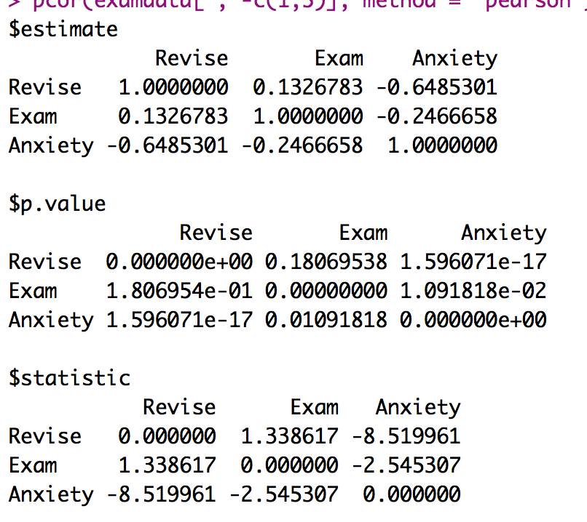

Slide 56
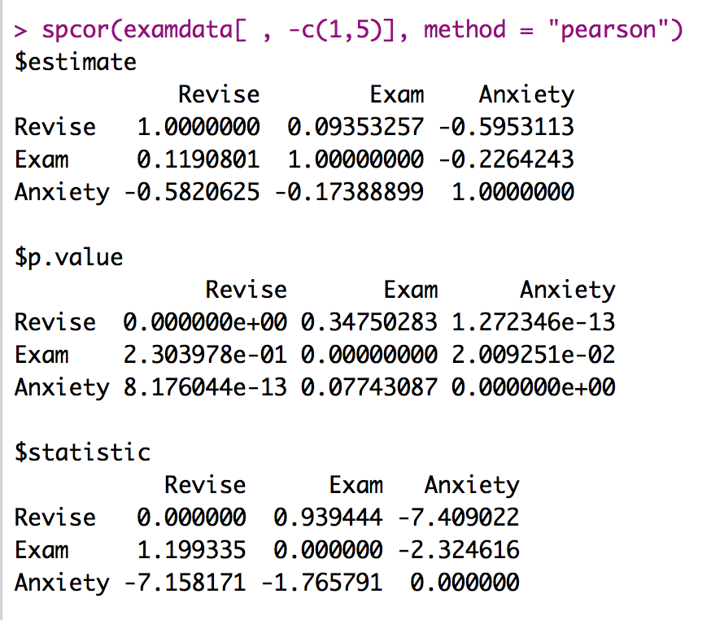
Semipartial Correlations
spcor(data, method = “pearson”)
Notice how top and bottom half are not equal.
Calculated as:
Correlation between 1 and 2, given that 2 and 3 are correlated.
The first column = 1
The rest are 2/3

